Slide 1

Magellan and
Coronado
By: Mrs. Mays

Slide 2
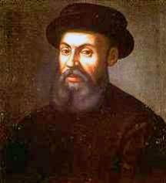
Ferdinand Magellan

Slide 3
Magellan
Ferdinand Magellan was a Portugese maritime (sea) explorer who sailed for the country of Spain (just like Columbus and Cortes). He led the 1st successful attempt to sail around the entire Earth!
Magellan = 1st attempt to go all the way around the world!

Slide 4
Magellan
He became the first person to lead an expedition sailing westward from Europe to Asia and to cross the Pacific Ocean.
Asia <<<<<< Pacific Ocean <<<<< Europe
(west) (west)
North
<<<<<<<<<<<<<<<<<<<<<<<<<<<<
West
East
South

Slide 5
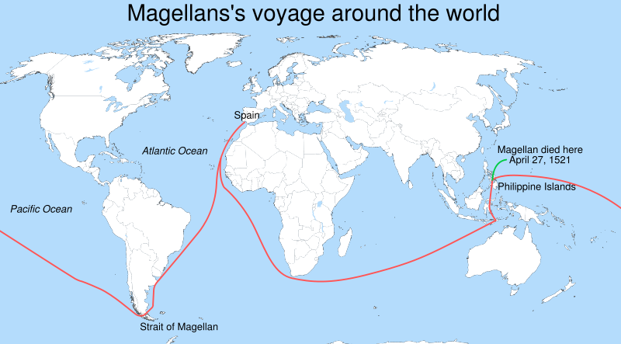
Starting point

Slide 6
Magellan
He did not complete his final, westward voyage; he was killed during the Battle of Mactan in the Phillipines (April 27, 1521). He did, however, die farther west than the Spice Islands of Indonesia, which he had visited from the west on earlier voyages, making him one of the 1st individuals to cross all the meridians of the globe.

Slide 7
Magellan
Of the 237-270 crew members who set out with Magellan to circumnavigate the globe, only 17 managed to return to Spain and complete the circumnavigation. They were led by Spaniard Juan Sebastián Elcano, who took over command of the expedition after Magellan's death.

Slide 8
Magellan was the first man to travel all the way around the world (circumnavigate Earth)…..well sort of. ☺

Slide 9
Magellan Quiz
1. Magellan sailed which direction from Europe to Asia? West
2. Which ocean did he cross? Pacific
3. What does circumnavigate mean?
To travel all the way around the world.
4. What country did he sail for? Spain
5. Where was Magellan from? Portugal

Slide 10
6. Did Magellan circumnavigate the world by himself? No
7. Why didn’t Magellan complete his trip?
He died.
8. Who finished the trip for him?
Juan Sebastian Elcano
9. He was the first man to cross all four what? Meridians.
10. How many men survived the trip? 17

Slide 11
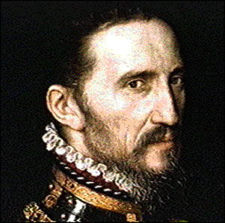
Coronado
“The Misfortunate Explorer”

Slide 12
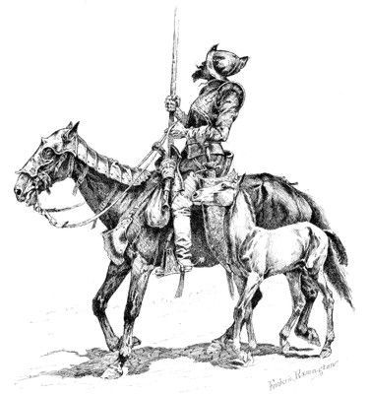
Coronado
Francisco Vázquez de Coronado was born in Spain. He became a Spanish conquistador who between 1540 and 1542 visited New Mexico and other parts of the southwest of what is now the United States.

Slide 13
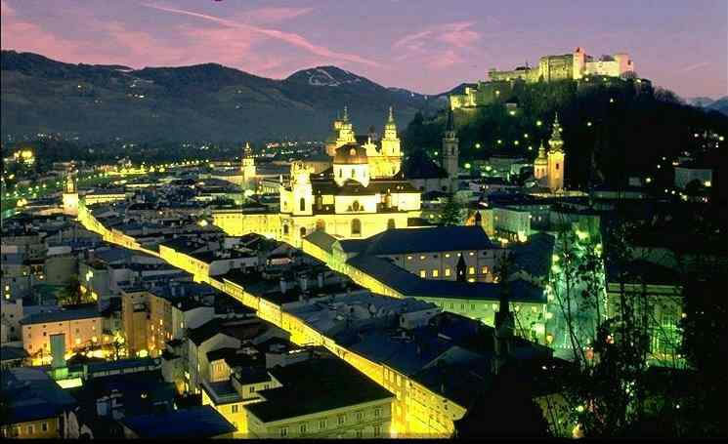
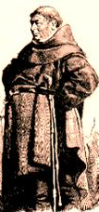
Coronado was in New Spain, near Mexico City when he began his expedition. He was told by Friar Marcos de Niza that there were 7 golden cities called “Cibola” and the Pacific Ocean within eyesight.
Friar

Slide 14
Coronado took over 2,000 men with him on his expedition North from Mexico into what is now known as the present-day state of New Mexico. On his way there he split up his men into several smaller groups and had them leave at different times and some travel different routes in order to make it to “Cibola”.

Slide 15
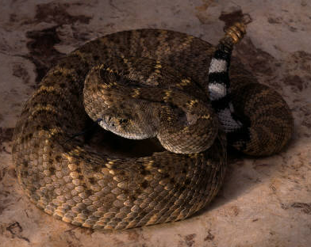
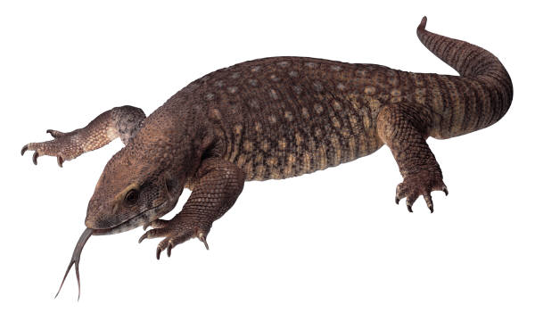
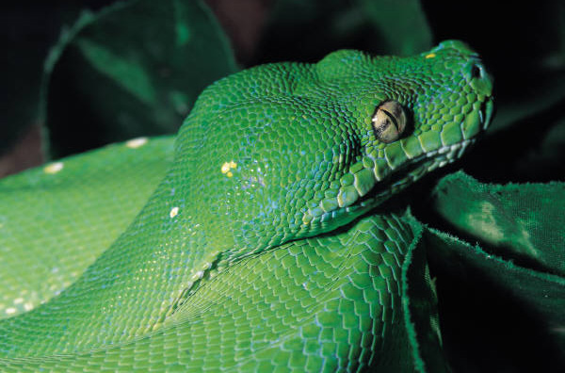
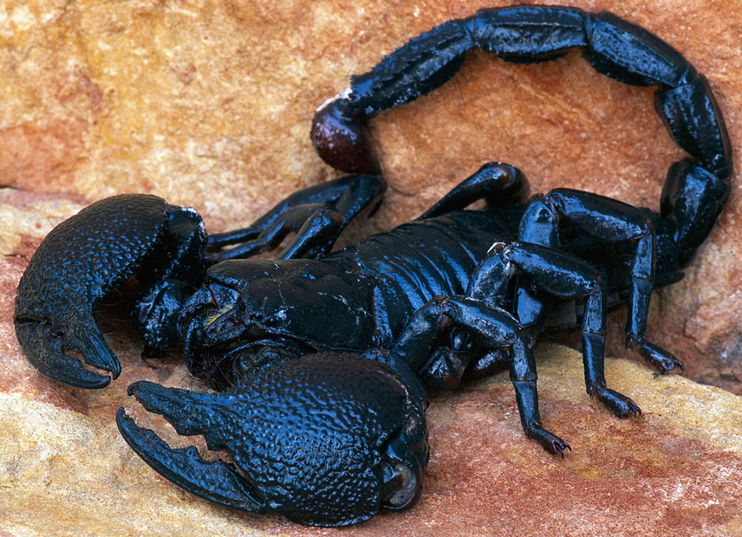
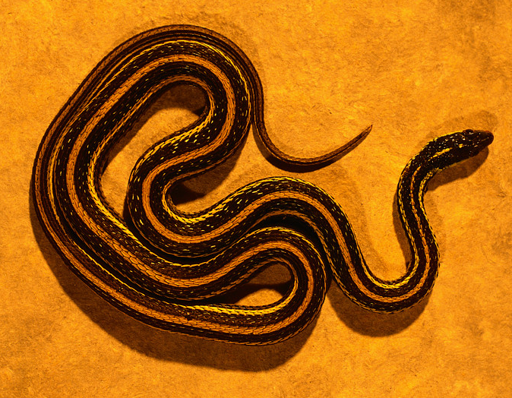
Before long, in an Indian ambush, Coronado's military advisor was pierced by an arrow.
The men encountered rattlesnakes, scorpions, huge lizards, and owls. Some of the men had never seen them before. Many of them died.
I jussssst love
5th gradersssss!

Slide 16
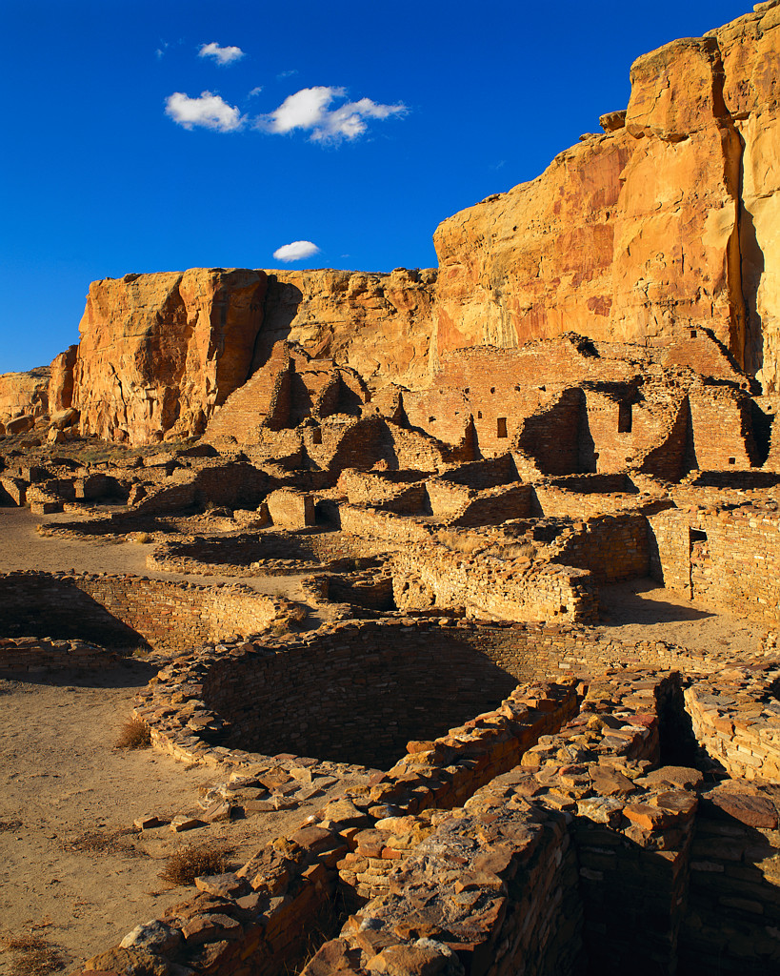
Coronado found Cibola. He and his men were very disappointed to find only a small tribe of Zuni Indians that lived in pueblos. The Zuni attacked the conquistadors. Coronado won the battle but was injured. He later recovered.

Slide 17
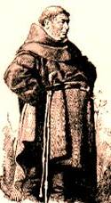
The golden city Friar Marcos De Niza spoke of didn’t actually exist. His soldiers wanted to kill the Friar, but instead Coronado forced him to return to Mexico in disgrace.

Slide 18
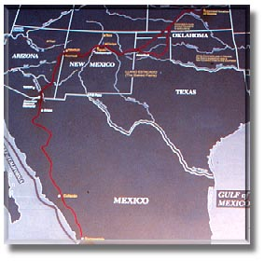
Coronado and his men continued to explore the rivers and land in the Southwest Region of what would soon be the United States of America.

Slide 19
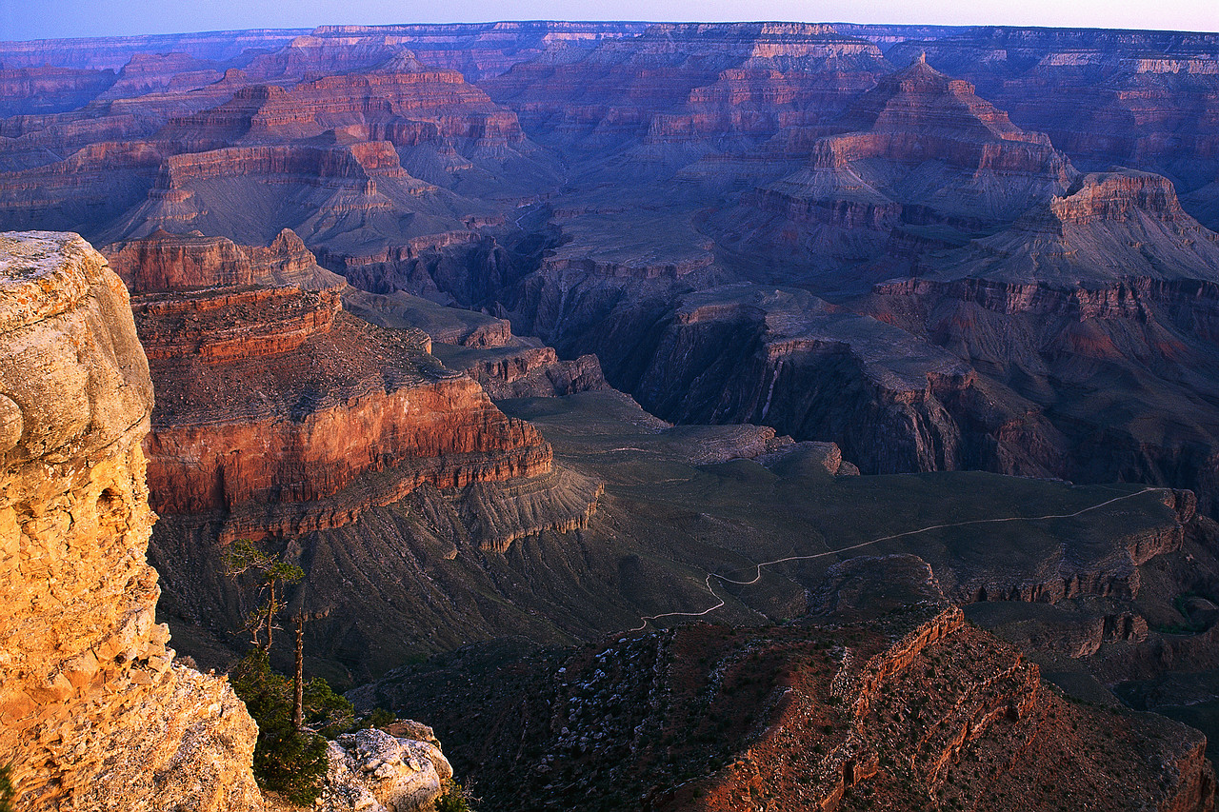
He was the first European to see the Grand Canyon in Arizona. He traveled through the panhandle of Texas, the panhandle of Oklahoma, and even parts of Kansas during his expeditions.

Slide 20
At one point he met an Indian he called “The Turk”. Turk told Coronado that he knew of Quivira, a rich country in the Northwest. During their voyage, Coronado suspected Turk was lying about the route and killed him.

Slide 21
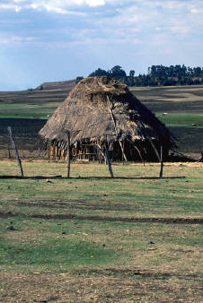
When he reached the Quivera Indians in Kansas, Coronado was once again disappointed. There was no rich country at all. The village consisted mostly of thatched huts, and not even small amounts of gold could be found.

Slide 22
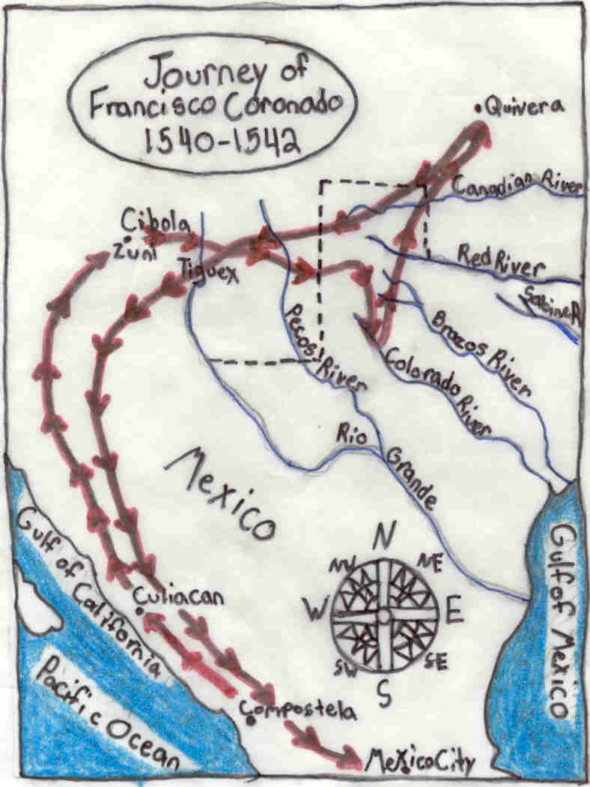
Look at some of the rivers Coronado and his men crossed.

Slide 23
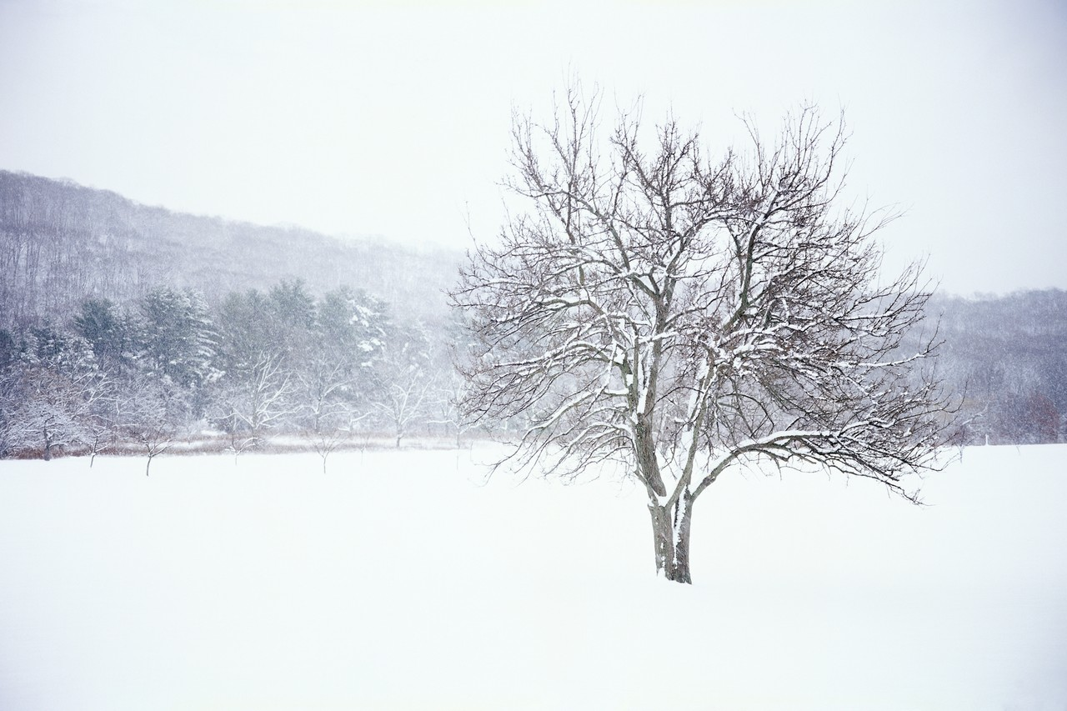
Throughout the harsh winters and the expedition, Coronado’s men ran out of supplies and began to get hungry.
The Indians were forced to share with them. Eventually battles broke out between Coronado’s groups of men and the Indians.

Slide 24
During the Tigeux War, one of the battles between Coronado’s men and the Indians, hundreds of Indians died.
It has been speculated that Coronado and his men were among the first to celebrate a type of Thanksgiving with the Indians of America after finding some lost food supplies. However, it’s not the same Thanksgiving we celebrate today.

Slide 25
Coronado returned home with only 100 men remaining. He had not discovered any golden cities or rich countries.

Slide 26
Coronado had invested a lot of his own money into his expeditions. When most of them had failed to help him find any gold or wealth, he soon became BANKRUPT. In fact, he returned home bankrupt (out of money). He later died in 1544.

Slide 27
Coronado Quiz
1. Coronado was looking for the city called “Cibola” also known as the 7 cities of gold.
2. Who told Coronado that this city existed?
Friar Marco De Niza
3. What did he find when he arrived?
Pueblos and no gold
4. Name one way some of his men died.
Hunger, animal bites, battles
5. Who went bankrupt at the end of the trip?
Coronado

Slide 28
6. Name five present-day states Coronado traveled through during his expedition.
NM TX AZ OK KS
7. Name one tribe of Indians he met. Zuni/Quivera
8. Did Coronado ever find a city of wealth or gold? no
List one of the two types of Indian housing mentioned. Thatched huts/pueblos
10. Coronado was the first explorer to see what famous present-day tourist destination?
The Grand Canyon
11. (Bonus) Why do you think Coronado has been labeled the “Misfortunate Explorer”?
He didn’t find what he searched for; lost all of his money; a lot of his men died.

Slide 29
This powerpoint was kindly donated to www.worldofteaching.com
http://www.worldofteaching.com is home to over a thousand powerpoints submitted by teachers. This is a completely free site and requires no registration. Please visit and I hope it will help in your teaching.

